Slide 1

SMART INDIA HACKATHON 2026
DISHA-AI
From a business idea to a clearer local and financial roadmap.
Problem Statement ID – SIH26091
Problem Statement Title- AI-Driven Local Business Advisory and Financial Structuring Assistant for Rural Micro-Entrepreneurs.
Theme- AI, ML, FinTech, Analytics
PS Category- Software
Team ID-
Team Name- Code Architects
1

Slide 2

PROPOSED SOLUTION
Code
Architects
What is DISHA?
DISHA is an AI-powered business advisory application designed to help aspiring and existing entrepreneurs make informed business decisions.
How it addresses the problem
Provides personalized business guidance based on user requirements.
Recommends relevant government schemes, loans, subsidies, and support programs.
Checks basic eligibility based on user and business information.
Simplifies complex government and business information using AI.
Provides guidance through a simple and user-friendly conversational interface.
Innovation and Uniqueness
Combines AI business advisory + scheme recommendation in one platform.
Provides personalized recommendations instead of generic information.
Makes business and government support information easier to understand.
Can support multilingual interaction for improved accessibility.
Web Link: https://disha-sih-2026.web.app/

Slide 3
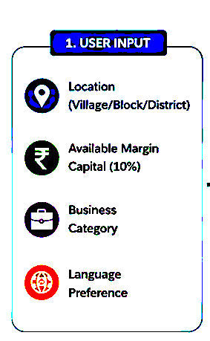
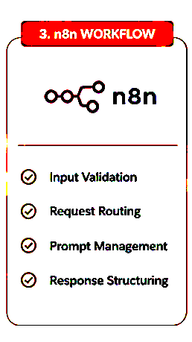
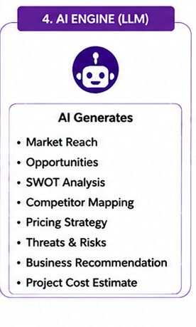
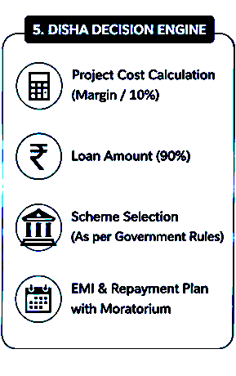
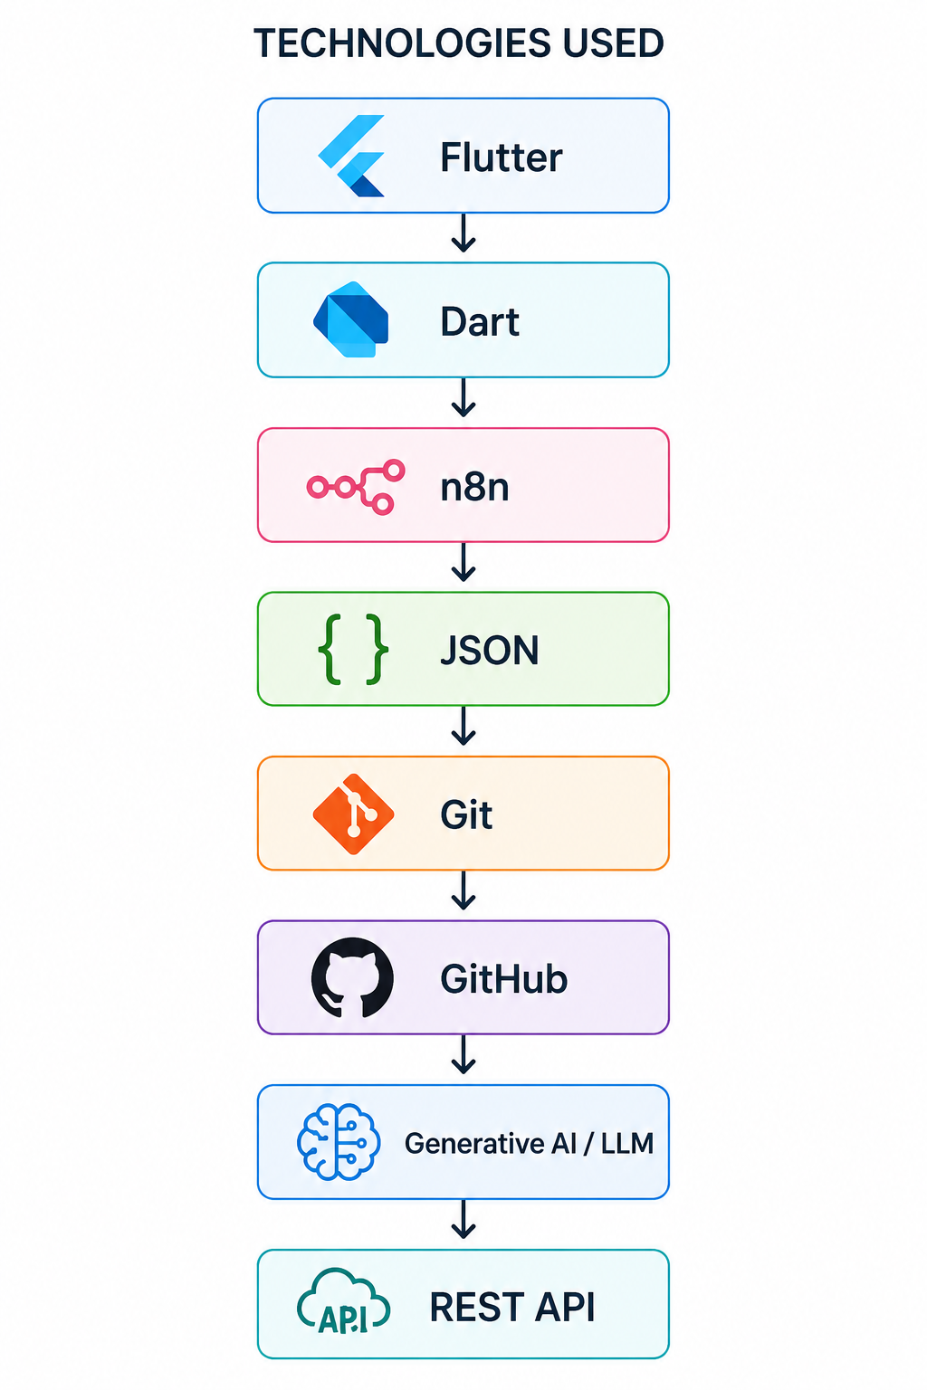
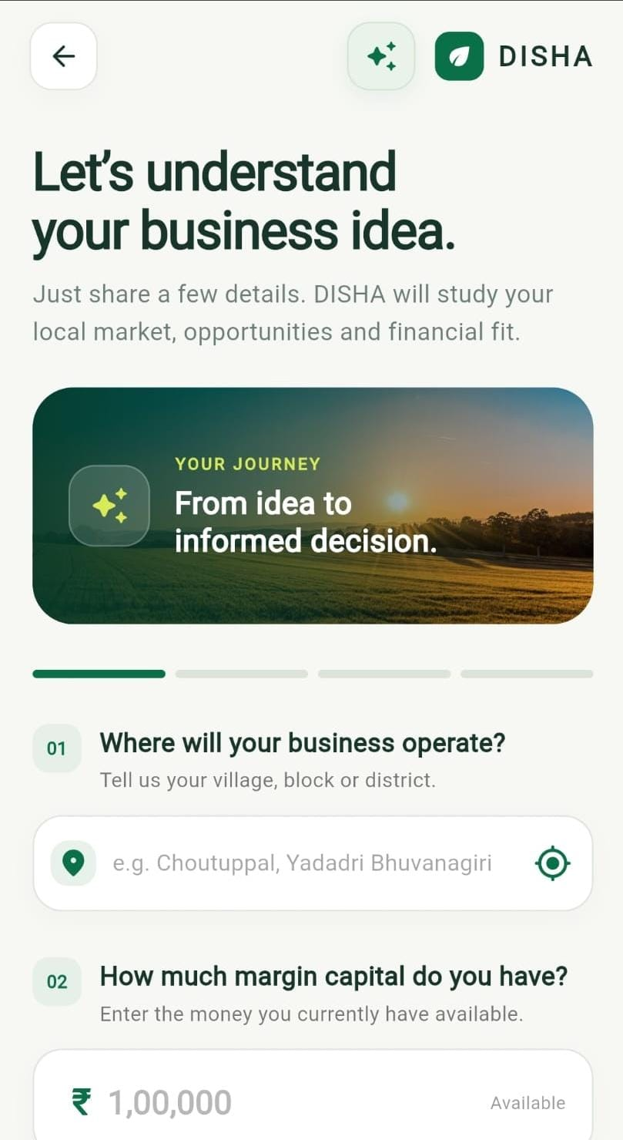
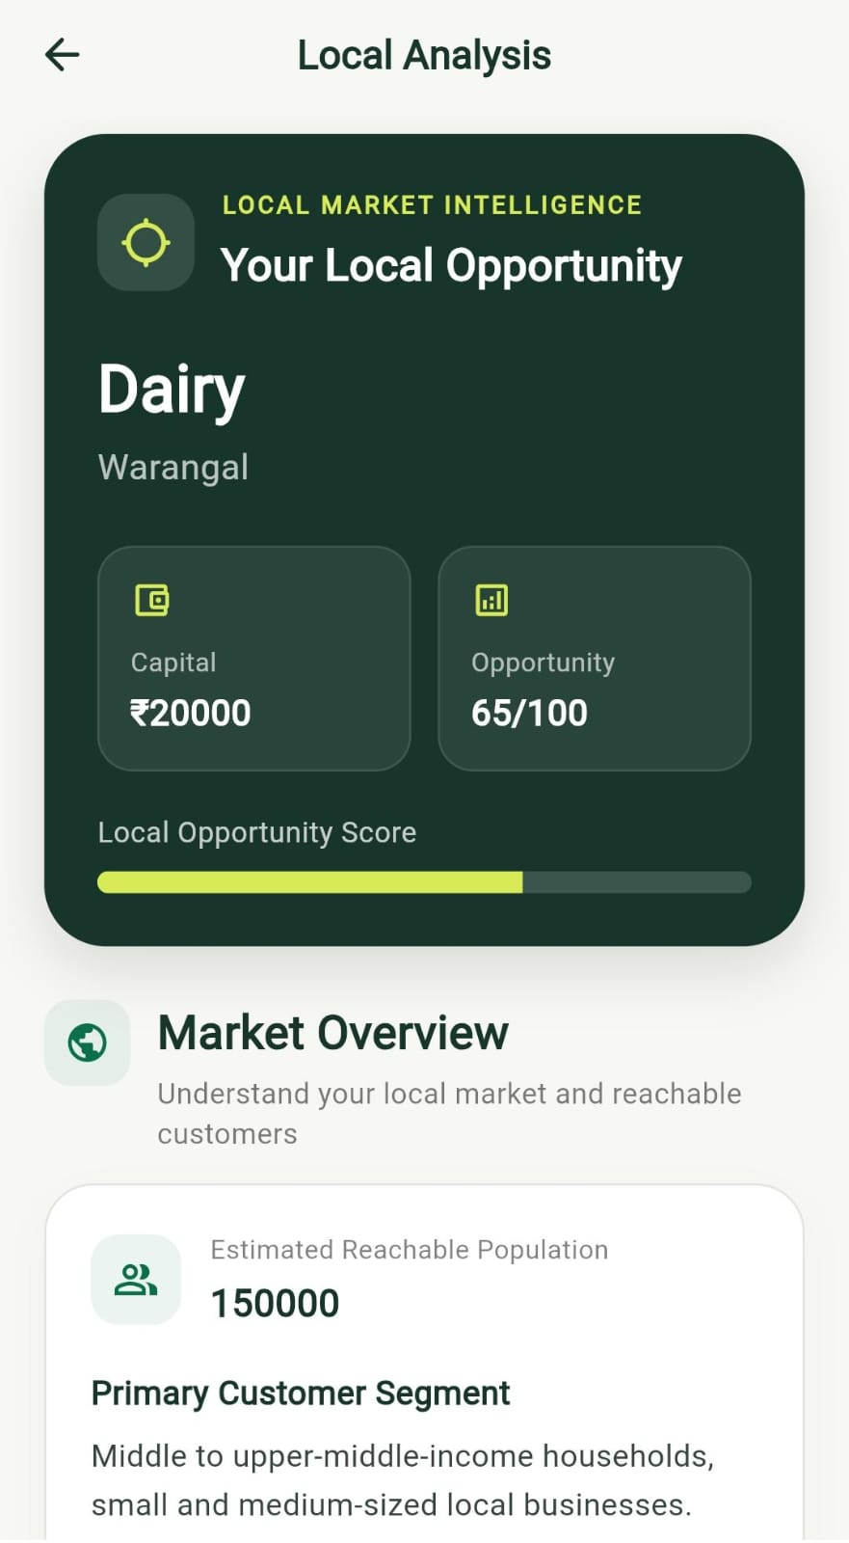
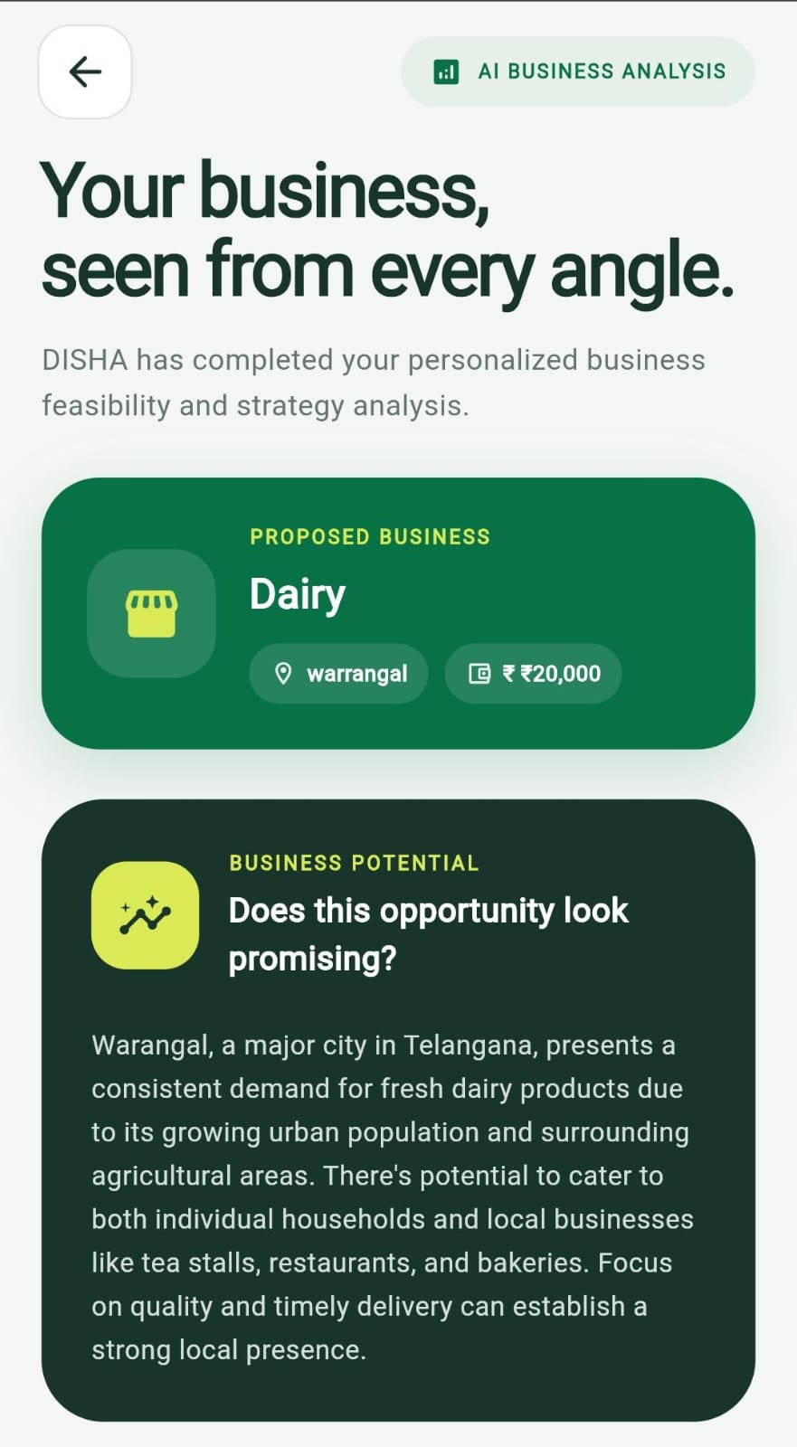
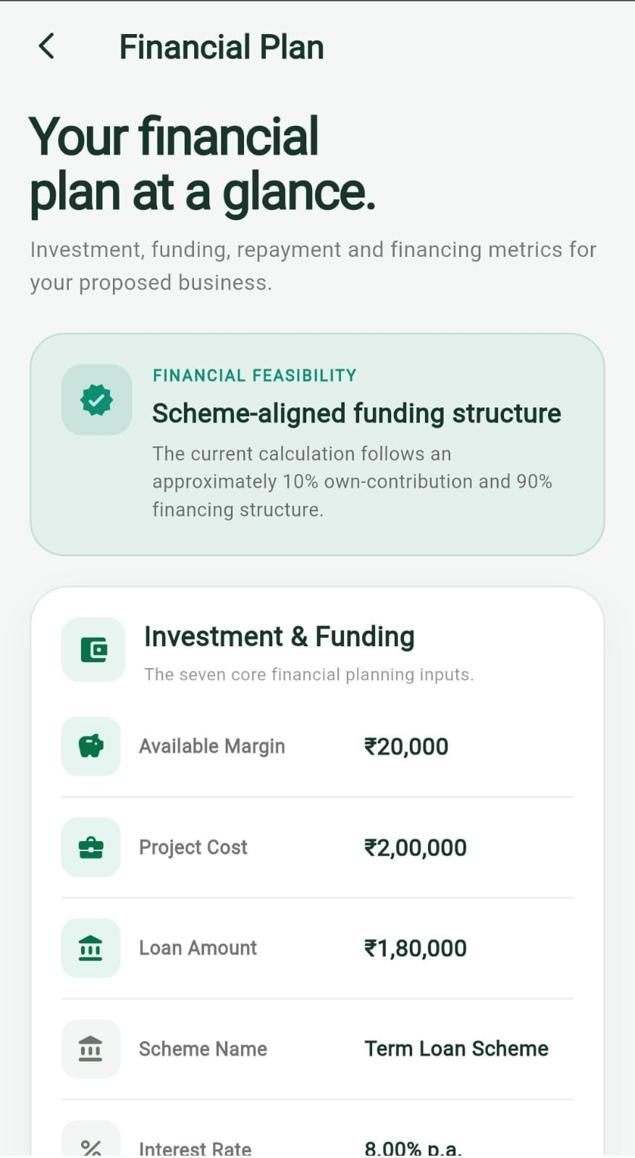
TECHNICAL APPROACH
Code
Architects
A simple journey from business idea to action plan
1
Business details
Workflow
3
AI business insights
2
4
Financial evaluation
5

Slide 4
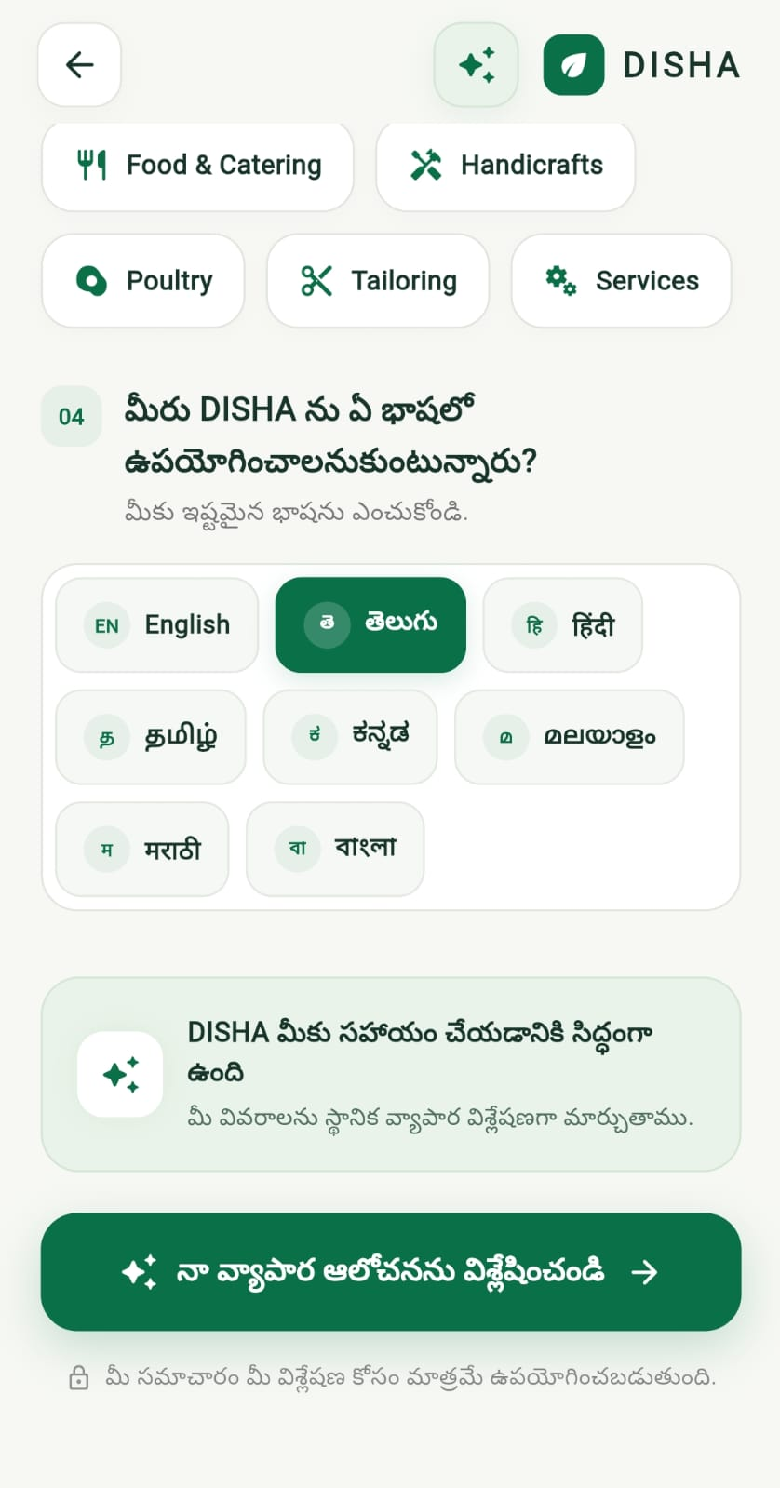
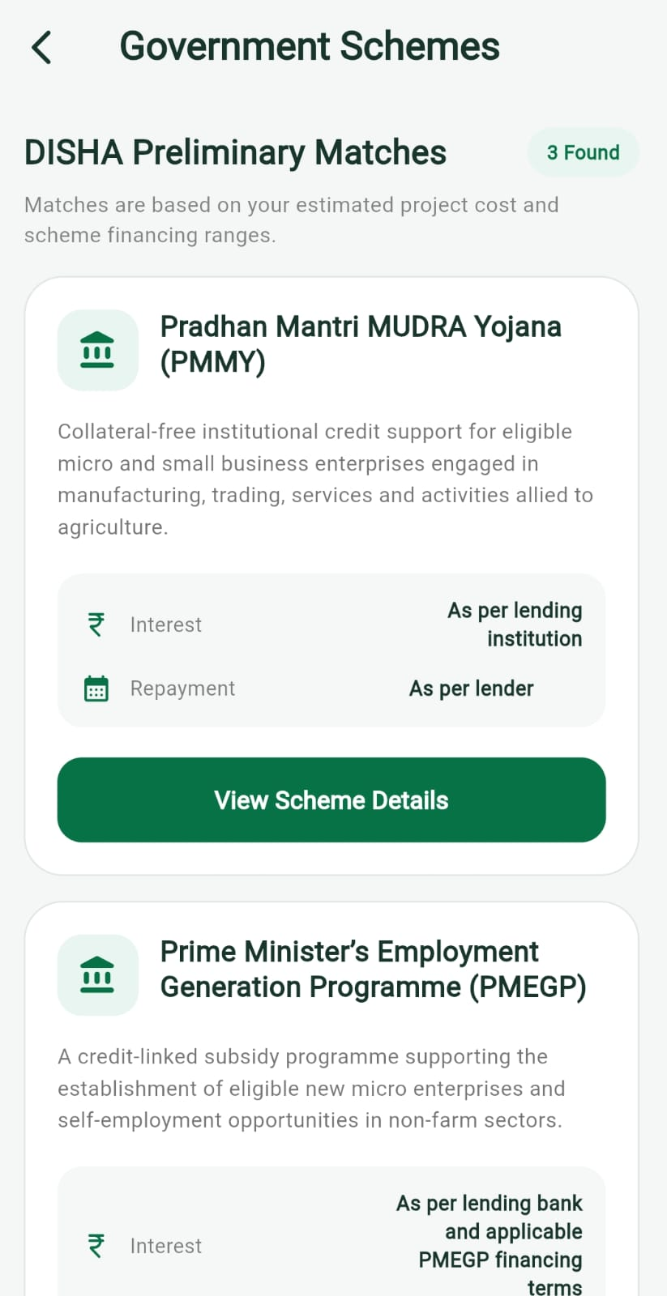
FEASIBILITY AND VIABILITY
Code
Architects
Technical Feasibility
Economic Viability
LLMs can understand user queries and provide personalized guidance.
Government scheme information can be organized into a searchable knowledge base.
The application allows multiple languages so that the user can understand more clear
Open-source technologies and scalable cloud services can reduce initial costs.
AI automation reduces the requirement for extensive human advisory support.
Potential revenue through premium services and institutional partnerships.
Potential Challenges
Strategies to Overcome Challenges
Keeping scheme information updated.
Ensuring accurate AI-generated recommendations.
Protecting user and business data.
Regular updates from official sources.
AI responses supported by verified information.
Secure authentication and data protection mechanisms.

Slide 5
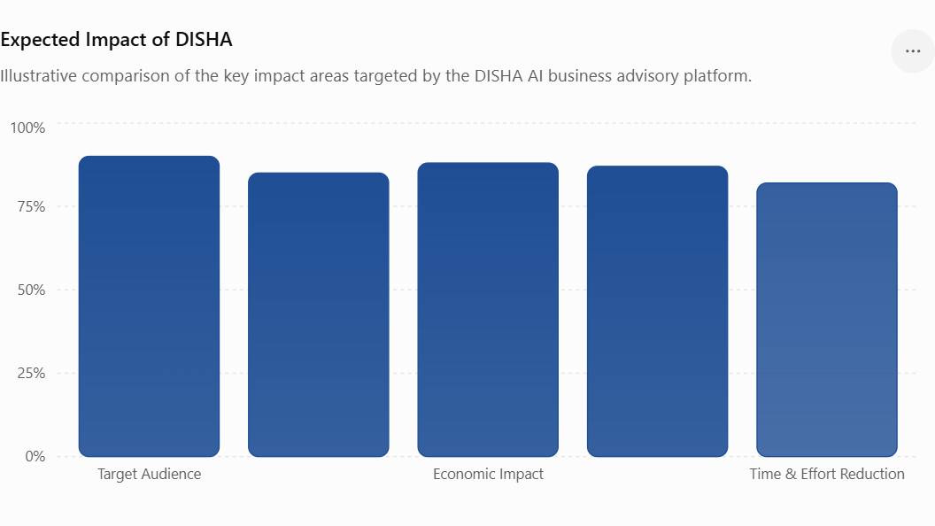
IMPACT AND BENEFITS
Code
Architects
Impact on Target Users
Economic Benefits
Helps aspiring entrepreneurs understand available business opportunities.
Reduces the difficulty of finding suitable government schemes and financial support.
Saves time by providing relevant information in one platform.
Makes business guidance more accessible to people with limited knowledge of government processes.
Helps entrepreneurs identify suitable financial support opportunities.
Reduces information gaps in accessing government schemes.
Can contribute to the growth of small businesses and startups
Social Benefits
Promotes entrepreneurship and self-employment.
Improves access to business-related information.
Supports users from different linguistic and educational backgrounds.

Slide 6
RESEARCH AND REFERENCES
Code
Architects
REFERENCE LINKS
Udyam Registration — Government of India
Description: Official MSME registration and classification platform used to identify and classify micro, small and medium enterprises.
Link: https://udyamregistration.gov.in/
ASPIRE — Ministry of MSME
Description: Government initiative promoting innovation, rural industries, entrepreneurship and livelihood-based micro-enterprises through incubation and support.
Link: https://aspire.msme.gov.in/ASPIRE/AFHome.aspx
PMEGP — Prime Minister’s Employment Generation Programme
Description: Government scheme supporting new micro-enterprises through financial assistance, entrepreneurship development and employment generation, particularly relevant to rural business creation.
Link: https://www.kviconline.gov.in/pmegpeportal/pmegphome/index.jsp
RESEARCH PAPERS
➢ Government Policies and MSME Growth in India
Description: Examines how government policies and initiatives support MSME growth and entrepreneurship.
Google Scholar: https://scholar.google.com/scholar?q=Government+Policies+and+MSME+Growth+in+India
➢ Awareness of Government Schemes among MSME Entrepreneurs
Description: Studies how awareness of government schemes affects entrepreneurs and MSME development.
Google Scholar: https://scholar.google.com/scholar?q=Awareness+of+Government+Schemes+among+MSME+Entrepreneurs
➢ PMEGP and Entrepreneurship Development in India
Description: Analyses the role of PMEGP in supporting entrepreneurship and generating employment.
Google Scholar: https://scholar.google.com/scholar?q=PMEGP+and+Entrepreneurship+Development+in+India

